Slide 1
How AI Works & Why You Are Important (in 45 minutes)
Lisa Yan
(with slides from Chris Piech)

Slide 2
Announcements
Final Project due at 6pm!
Ceren’s user study:
Consent forms will be handed out Lab 3
Email to come soon (with instructions)
Do this AFTER you’ve submitted your project ☺
CS Bridge exit survey: fill out during Lab 3

Slide 3
Where is my robot?

Slide 4
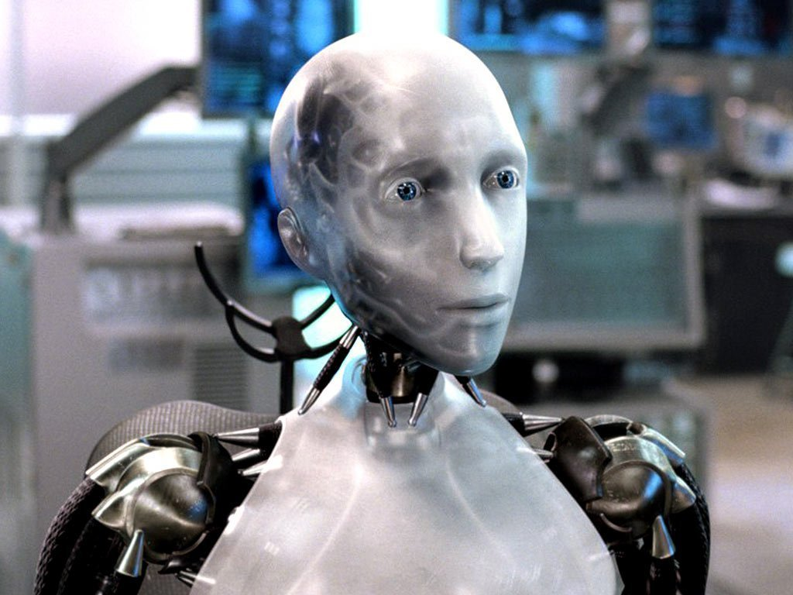
Sci-Fi Has Promised Me Robots

Slide 5
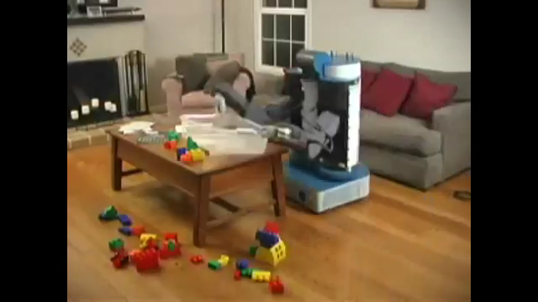
House Cleaning Robot
Notes:
2008 wyrobek, willow garage
Towards a Personal Robotics Development Platform: Rationale and Design of an Intrinsically Safe Personal Robot Keenan A. Wyrobek, Eric H. Berger, H.F. Machiel Van der Loos, Member, IEEE, and J. Kenneth Salisbury, Member, IEEE

Slide 6
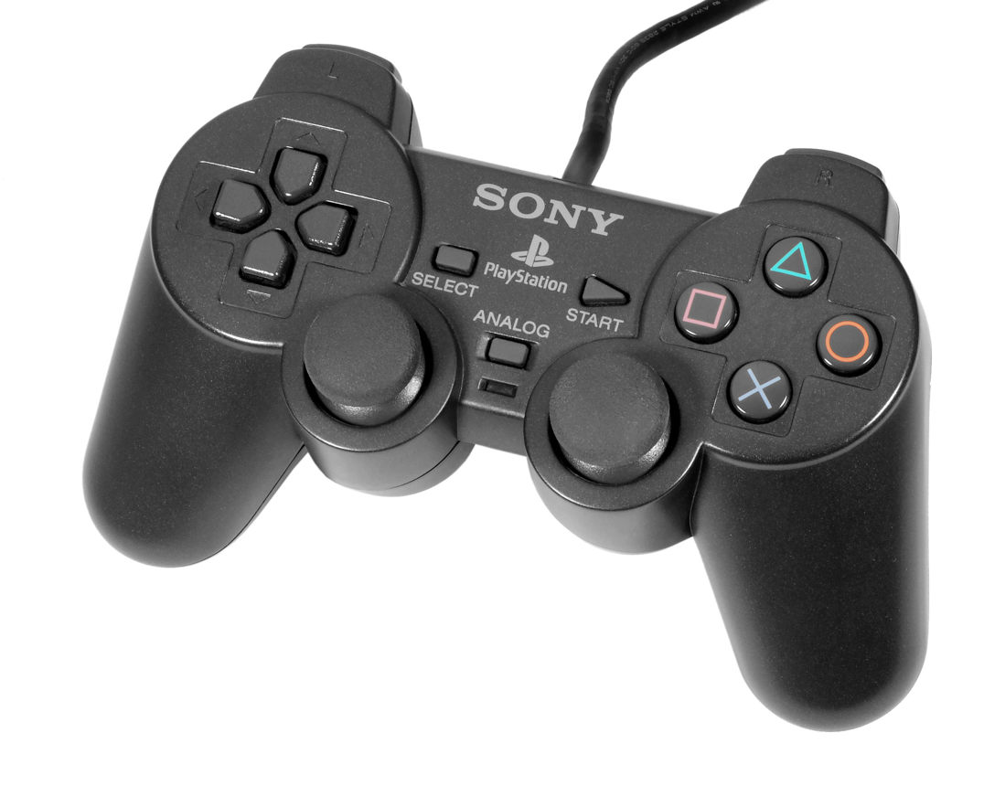
House Cleaning Robot

Slide 7
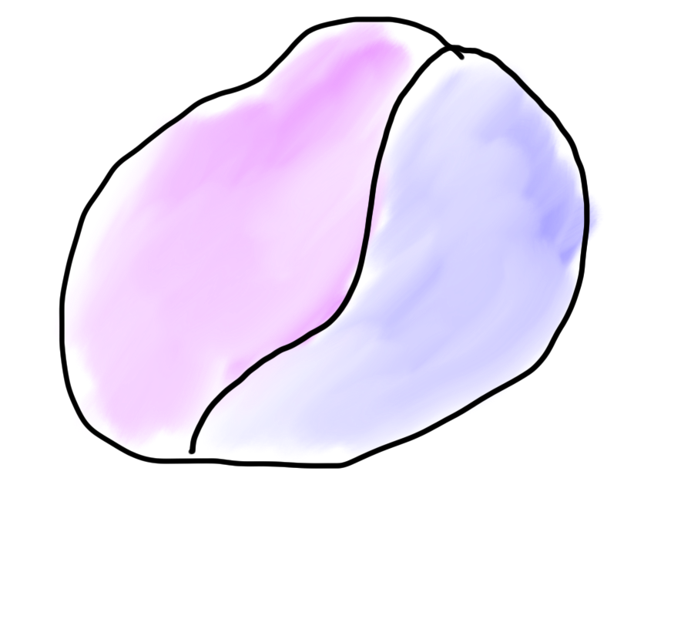

Robots?
Mind
Body
🤔

Slide 8
What is AI?

Slide 9
[suspense]

Slide 10
Computer
programs
AI: The study and design of intelligent agents.
Better than
chance
As well as
humans

Slide 11
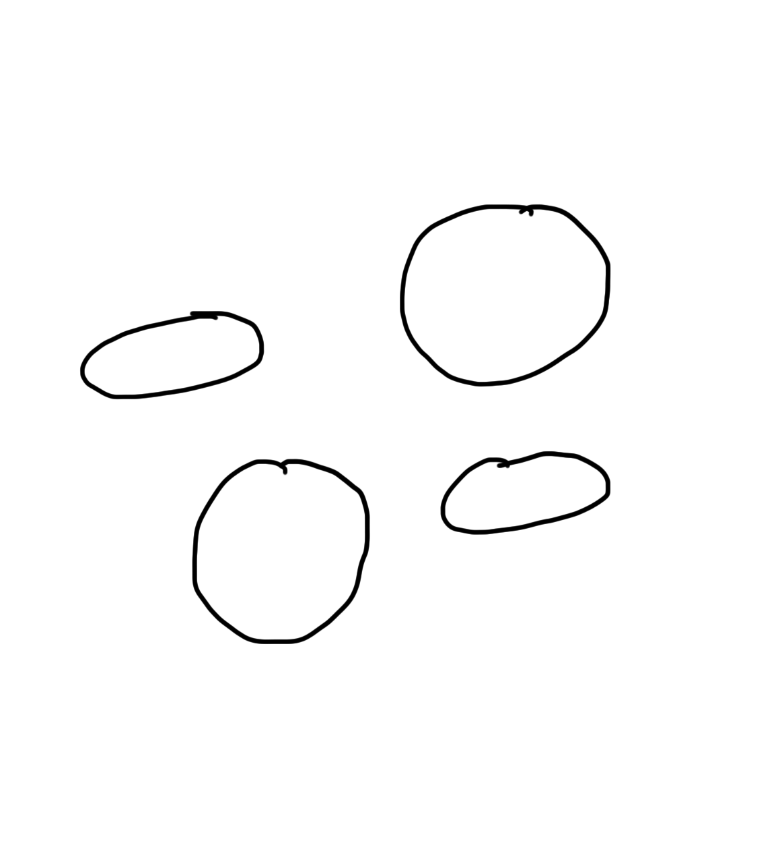
Narrow Intelligence
Translate
Turkish
Play Chess
Play Breakout
Drive a
Car

Slide 12
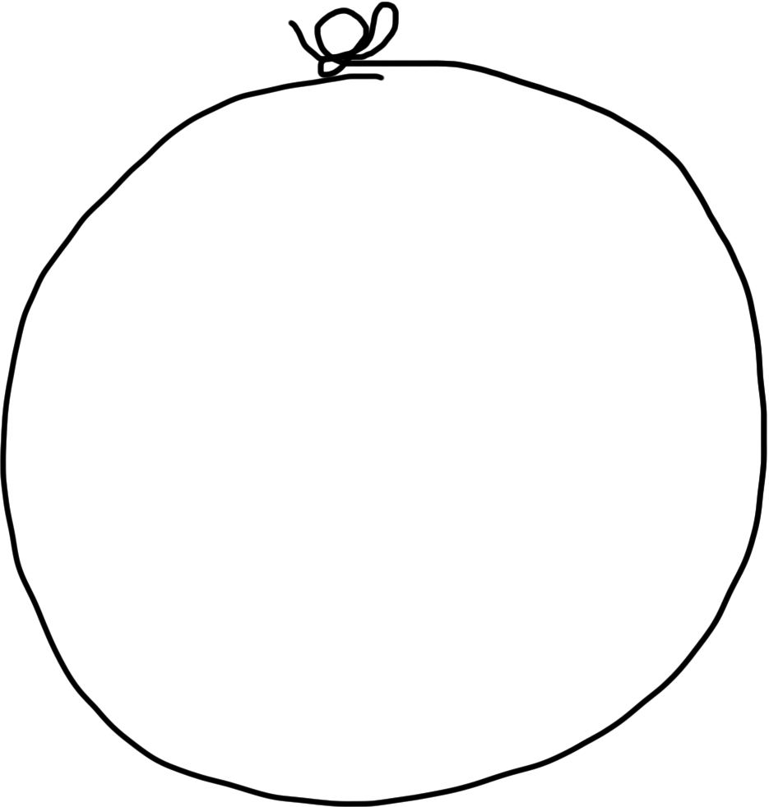
General Intelligence
Translate
Turkish
Play Chess
Play Breakout
Drive a
Car

Slide 13
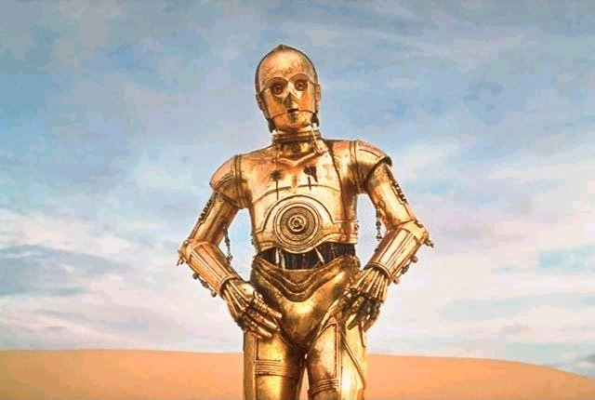
Brief History

Slide 14
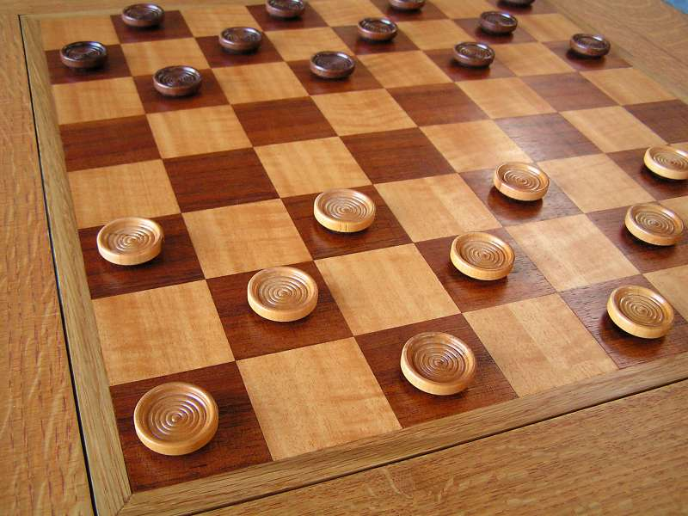
Early Optimism 1950s
1952
Notes:
Checkers, IBM, a person named Arthur Samuel

Slide 15
Early Optimism (1950s)
“Machines will be capable, within twenty years, of doing any work a man can do.”
–Herbert Simon, 1952

Slide 16
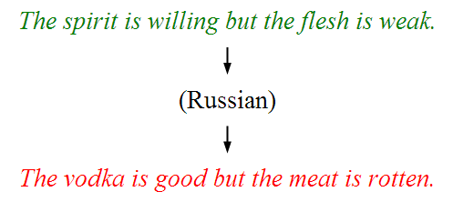
Underwhelming Results (1950s–1980s)
The world is too complex!

Slide 17





Modern Game of AI
2014

Slide 18

Told Speech Was 30 Years Out
Almost perfect…
Notes:
https://twitter.com/kid_chrissy/status/1082472189725687808

Slide 19
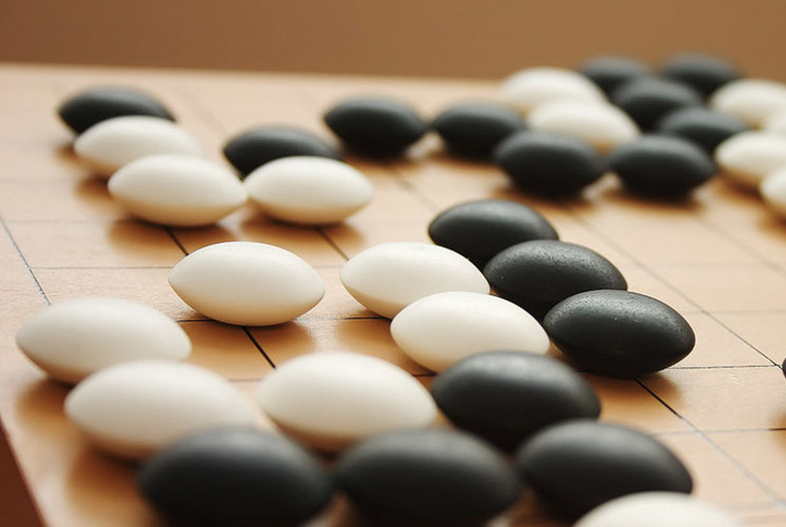
The Last Remaining Board Game
Notes:
AlphaGo, 2016 (Lee Sedol, Korea) Google DeepMind

Slide 20
Computers Making Art

Slide 21
Self-driving Cars
Notes:
2016 google car..

Slide 22
What is going on?

Slide 23
[more suspense]

Slide 24
Story of Modern AI:
Focus on one problem

Slide 25
Make a Harry Potter Sorting Hat

Slide 26

Classification
Logistic Regression is like the Harry Pottery Sorting Hat
That is a picture
of a one

Slide 27

Classification
Logistic Regression is like the Harry Pottery Sorting Hat
That is a picture
of a zero

Slide 28

Classification
That is a picture
of an zero
* It doesn’t have to be correct all of the time

Slide 29
Can you do it?

Slide 30

What number is this?

Slide 31

What number is this?

Slide 32

How about now?
What a computer sees
0 | 0 | 1 | 0 | 1 | 0 | 1 | 0 | 0 | 0 | 1 | 1 | 1 | 0 | 1
1 | 0 | 0 | 1 | 0 | 1 | 1 | 1 | 0 | 1 | 0 | 0 | 0 | 0 | 0
1 | 1 | 1 | 0 | 1 | 0 | 0 | 1 | 1 | 0 | 0 | 1 | 0 | 1 | 0
1 | 1 | 1 | 1 | 1 | 0 | 0 | 0 | 0 | 0 | 1 | 1 | 0 | 1 | 1
0 | 0 | 0 | 1 | 1 | 0 | 0 | 1 | 0 | 0 | 0 | 1 | 1 | 1 | 0
1 | 0 | 0 | 1 | 1 | 0 | 0 | 0 | 1 | 0 | 1 | 1 | 1 | 1 | 0
1 | 1 | 0 | 1 | 1 | 0 | 0 | 1 | 1 | 0 | 1 | 1 | 1 | 0 | 0
1 | 0 | 1 | 0 | 0 | 1 | 0 | 0 | 1 | 0 | 0 | 1 | 1 | 1 | 1
0 | 0 | 0 | 0 | 1 | 0 | 1 | 0 | 1 | 1 | 0 | 0 | 1 | 1 | 1
0 | 1 | 1 | 0 | 0 | 0 | 0 | 0 | 1 | 1 | 1 | 1 | 1 | 1 | 0
0 | 0 | 1 | 0 | 1 | 1 | 1 | 0 | 0 | 0 | 1 | 0 | 0 | 0 | 0
0 | 1 | 1 | 1 | 0 | 1 | 0 | 0 | 1 | 0 | 0 | 0 | 0 | 0 | 1
1 | 1 | 0 | 0 | 0 | 0 | 0 | 0 | 0 | 0 | 1 | 0 | 0 | 1 | 1
0 | 0 | 0 | 0 | 0 | 0 | 0 | 0 | 1 | 1 | 1 | 1 | 0 | 0 | 1
0 | 0 | 1 | 1 | 1 | 0 | 1 | 0 | 1 | 1 | 0 | 0 | 0 | 1 | 0
What a human sees

Slide 33
Why is it easy for Humans?
About 30% of your cortex is used from vision
3% is used to process hearing

Slide 34
Very hard to Program
??
public class HarryHat extends ConsoleProgram {
public void run() {
println("Todo: Write program");
}
}

Slide 35
Perhaps there is an insight?

Slide 36
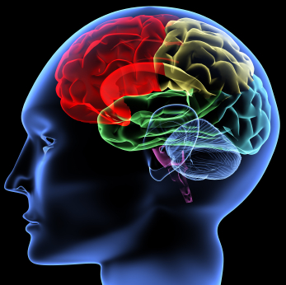
One Algorithm Hypothesis
Much of perception in the brain can be explained with a single learning algorithm.
[Andrew Ng]

Slide 37

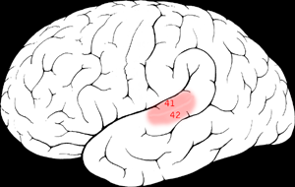

One Algorithm Hypothesis
Auditory Cortex
Auditory cortex learns to see
[Roe et al., 1992]
[Andrew Ng]

Slide 38
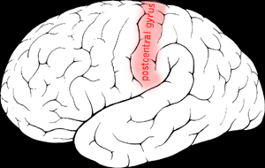

One Algorithm Hypothesis
Somatosensory Cortex
Somatosensory cortex learns to see
[Metin & Frost, 1989]
[Andrew Ng]

Slide 39
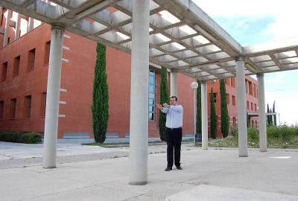
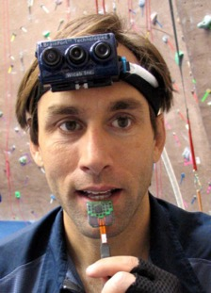
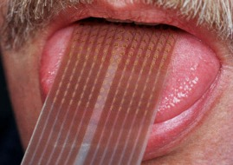
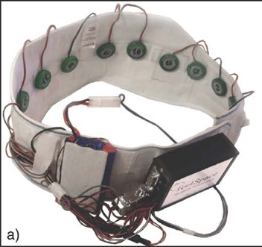
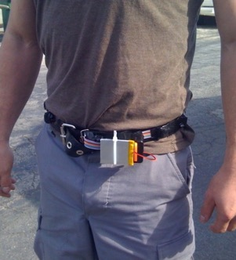
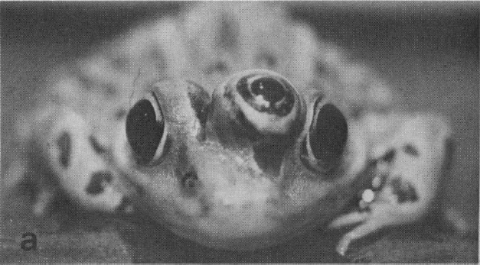
Sensor Representations
Seeing with your tongue
Human echolocation (sonar)
Haptic belt: Direction sense
Implanting a 3rd eye
[BrainPort; Welsh & Blasch, 1997; Nagel et al., 2005; Constantine-Paton & Law, 2009]

Slide 40
Two Great Ideas
Story of Modern AI:
1. Artificial Neurons
2. Learn by Example
Machine Learning

Slide 41
1. Artificial Neurons

Slide 42
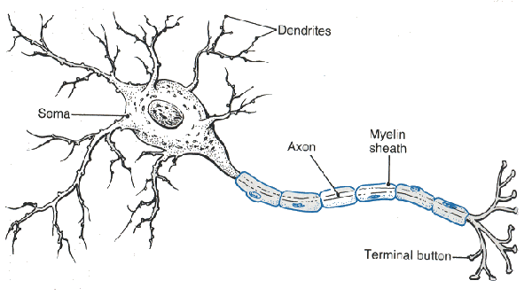
Neuron

Slide 43
Neuron

Slide 44
Neuron

Slide 45
Neuron

Slide 46
Neuron

Slide 47
Some Inputs are More Important

Slide 48
Artificial Neuron

Slide 49

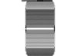


Inputs
+

Slide 50
Inputs
+

Slide 51
Inputs
+

Slide 52
Weights
+

Slide 53
Weights
+

Slide 54
Weights
+

Slide 55
Weighted Sum
+
double weightedSum = 0;
weightedSum += input0 * weight0;
weightedSum += input1 * weight1;
weightedSum += input2 * weight2;
weightedSum += input3 * weight3;

Slide 56
Filter and Output
+

Slide 57
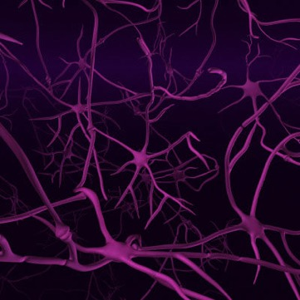
Biological Basis
A neuron
Your brain
(actually, probably someone else’s brain)
???

Slide 58




Put Many Together
+
+
+
+

Slide 59
Put Many Together
Input Neurons
Hidden Neurons
Output Neurons

Slide 60
Making a Prediction
…
Input Neurons
Hidden Neurons
Output Neurons

Slide 61
Making a Prediction
…
Input Neurons
Hidden Neurons
Output Neurons

Slide 62
Making a Prediction
…
Input Neurons
Hidden Neurons
Output Neurons

Slide 63
Making a Prediction
I think that is a picture of a one!
…
Input Neurons
Hidden Neurons
Output Neurons

Slide 64
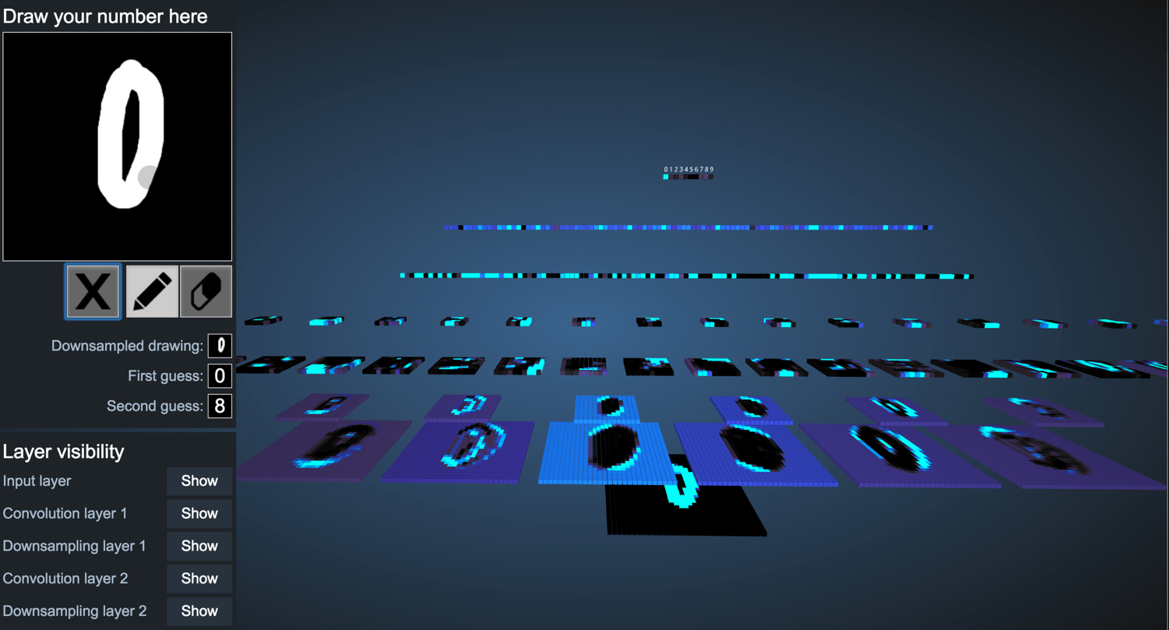
You Can Try It Yourself
http://scs.ryerson.ca/~aharley/vis/conv/

Slide 65
Great Idea: Artificial Neurons

Slide 66
Two Great Ideas
1. Artificial Neurons
2. Learn by Example

Slide 67
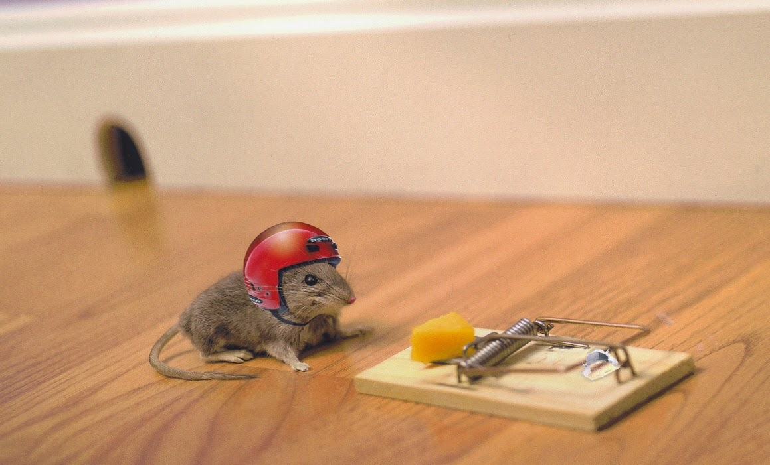
2. Learn From Experience

Slide 68
Neural Networks gets their intelligence from its sliders (aka its weights)

Slide 69
Neural Network
Input Neurons
Hidden Neurons
Output Neurons

Slide 70
Neural Network
+
+
+
+

Slide 71

Learn by Example

Slide 72



+

Slide 73
I think that is a picture of a one!
+
Oh what, it’s a zero??
Ill adjust my sliders so that I do better.

Slide 74
I think that is a picture of a one!
+
Oh what, it’s a zero??
Ill adjust my sliders so that I do better.

Slide 75
+

Slide 76
+

Slide 77
I think that is a picture of a one!
+
Woohoo, I got it right!!

Slide 78

+

Slide 79
I think that is a picture of a zero!
+
Oh what, it’s a one??
I’ll adjust my sliders so that I do better.

Slide 80
I think that is a picture of a zero!
+
Oh what, it’s a one??
I’ll adjust my sliders so that I do better.

Slide 81
Study Hard!

Slide 82
Train on Faces

Slide 83

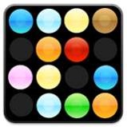
Visualize the Sliders
object models
object parts
(combination
of edges)
Training set: Aligned
images of faces.
edges
pixels
[Honglak Lee]

Slide 84
Woah… that’s like a brain…

Slide 85
True.

Slide 86
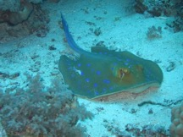
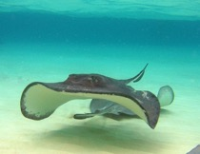

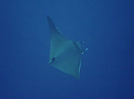


ImageNet Decomposition
…
smoothhound, smoothhound shark, Mustelus mustelus
American smooth dogfish, Mustelus canis
Florida smoothhound, Mustelus norrisi
whitetip shark, reef whitetip shark, Triaenodon obseus
Atlantic spiny dogfish, Squalus acanthias
Pacific spiny dogfish, Squalus suckleyi
hammerhead, hammerhead shark
smooth hammerhead, Sphyrna zygaena
smalleye hammerhead, Sphyrna tudes
shovelhead, bonnethead, bonnet shark, Sphyrna tiburo
angel shark, angelfish, Squatina squatina, monkfish
electric ray, crampfish, numbfish, torpedo
smalltooth sawfish, Pristis pectinatus
guitarfish
roughtail stingray, Dasyatis centroura
butterfly ray
eagle ray
spotted eagle ray, spotted ray, Aetobatus narinari
cownose ray, cow-nosed ray, Rhinoptera bonasus
manta, manta ray, devilfish
Atlantic manta, Manta birostris
devil ray, Mobula hypostoma
grey skate, gray skate, Raja batis
little skate, Raja erinacea
…
Stingray
Mantaray
Notes:
14 million images, 200 categories

Slide 87
0.005%
1.5%
Random guess
Pre Neural Networks (2012)
43.9%
73.1%
GoogLeNet (2015)
2017
Le, et al., Building high-level features using large-scale unsupervised learning. ICML 2012
Szegedy et al, Going Deeper With Convolutions, CVPR 2015
http://image-net.org/challenges/LSVRC/2017/results

Slide 88

Google Brain
1 Trillion Artificial Neurons
(btw, human brains have 1 billion neurons)

Slide 89
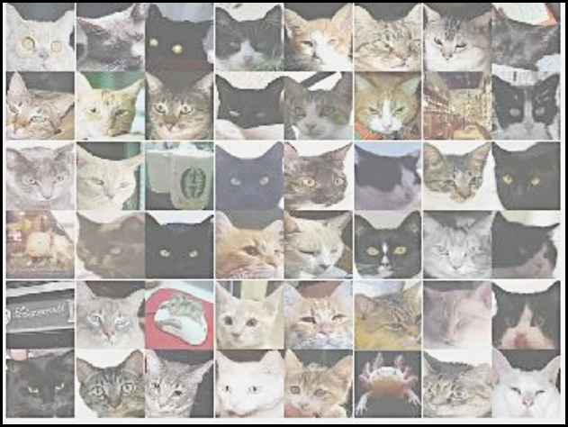
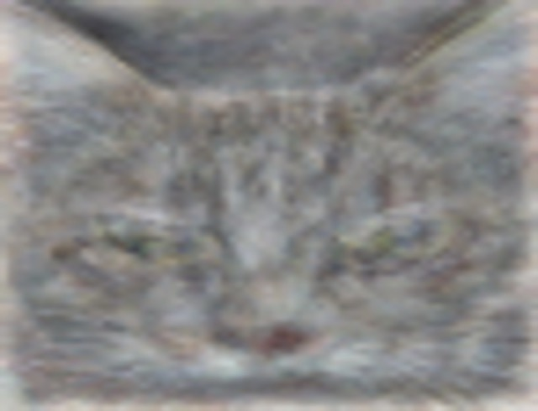
A Neuron That Fires When It Sees Cats
Top stimuli from the test set
Optimal stimulus
by numerical optimization
Le, et al., Building high-level features using large-scale unsupervised learning. ICML 2012

Slide 91





Other Neurons
Neuron 1
Neuron 2
Neuron 3
Neuron 4
Neuron 5
Le, et al., Building high-level features using large-scale unsupervised learning. ICML 2012
Input to another layer above
(image with 8 channels)
Number of output
channels = 8
LCN Size = 5
H
Pooling Size = 5
Number
of maps = 8
One layer
W
RF size = 18
Number of input
channels = 3
Image Size = 200

Slide 92
The Future of AI
Einstein
Human Intelligence
Performance
Complex Programs
Machine Learning
Time
Now
2012
Notes:
NVIDIA or ATI will be future of AI. Probably NVIDIA.

Slide 93
What’s the catch?

Slide 94
(1) Machine Learning Needs Data

Slide 95
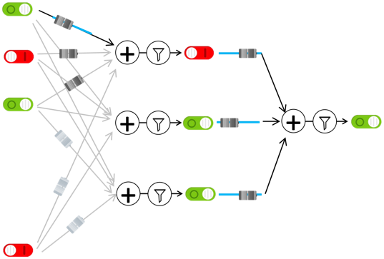
(1) Machine Learning Needs Data
(1) Get Data
(2) Train computer
Compiled by humans
Math and logic

Slide 96
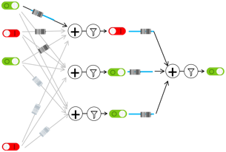
(1) Machine Learning Needs Data
Automatic YouTube captioning
Input: YouTube audio
Output: Captions
(1) Get Data
(2) Train computer
Female speaker error >
Male speaker error
Tatman, Gender and Dialect Bias in YouTube’s Automatic Captions, EthNLP 2017.

Slide 97
(1) Machine Learning Needs Data
Machine Translation
Language
English
(1) Get Data
(2) Train computer
Language | # challenges
German | 7
Czech | 6.5
Russian | 6
Finnish | 5
French,Turkish,Chinese | 3
German-Czech | 1
One-time appearances:
Hindi, Spanish, Lithuanian,
Romanian, Latvian, Estonian, Gujarati
Because the engineers all speak English!
Conference in Machine Translation (WMT), since 2013 http://www.statmt.org/wmt19/
Notes:
Gujarati: Indo-Aryan (India/Pakistan)

Slide 98
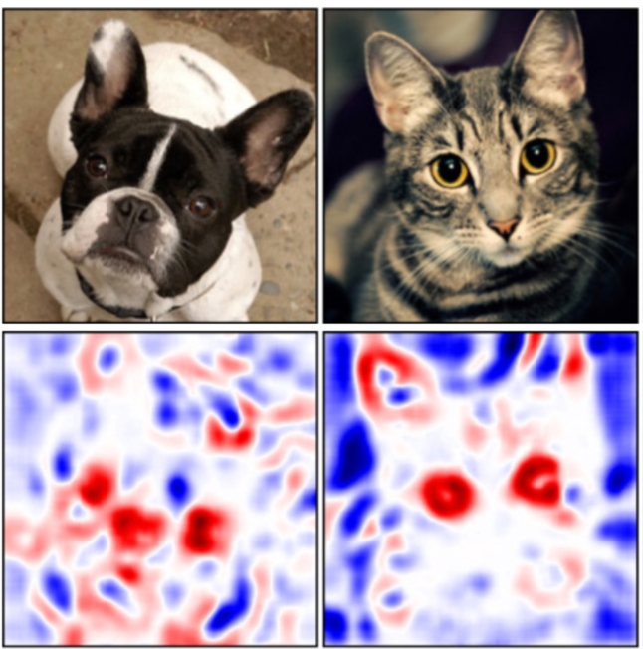
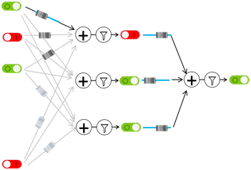
(2) How can we explain decisions?
Visualize sliders
Zintgraf et al., Visualizing Deep Neural Network Decisions: Prediction Difference Analysis, ICLR 2017

Slide 99
(2) How can we explain decisions?
That is a picture of a one!
??
black box
(probably fine)

Slide 100
(2) How can we explain decisions?
This person is dangerous!
??
black box
(not fine)

Slide 101
(3) How can we make it fair?
Should our data reflect society’s systemic bias?
Bolukbasi et al., Man is to Computer Programmer as Woman is to Homemaker? Debiasing Word Embeddings, NIPS 2016
Dataset: Google News

Slide 102






The current challenge
Understand data.
Then train your model.
Then make your system usable for real people.
I can help you better!
Quickly set up the bricks
Spent 2 hrs implementing mouse interactor
Tracy
Instructor

Slide 103
Where is my robot?
… coming soon

Slide 104

You can help
A little math

Slide 105
You can help
Understand; don’t assume

Slide 106
Can you do it?
(I explained to you the main components)
Not easy…
But yes. You can.

Slide 107

Path to AI

Slide 108
Why?

Slide 109

Closest Thing To Magic

Slide 110
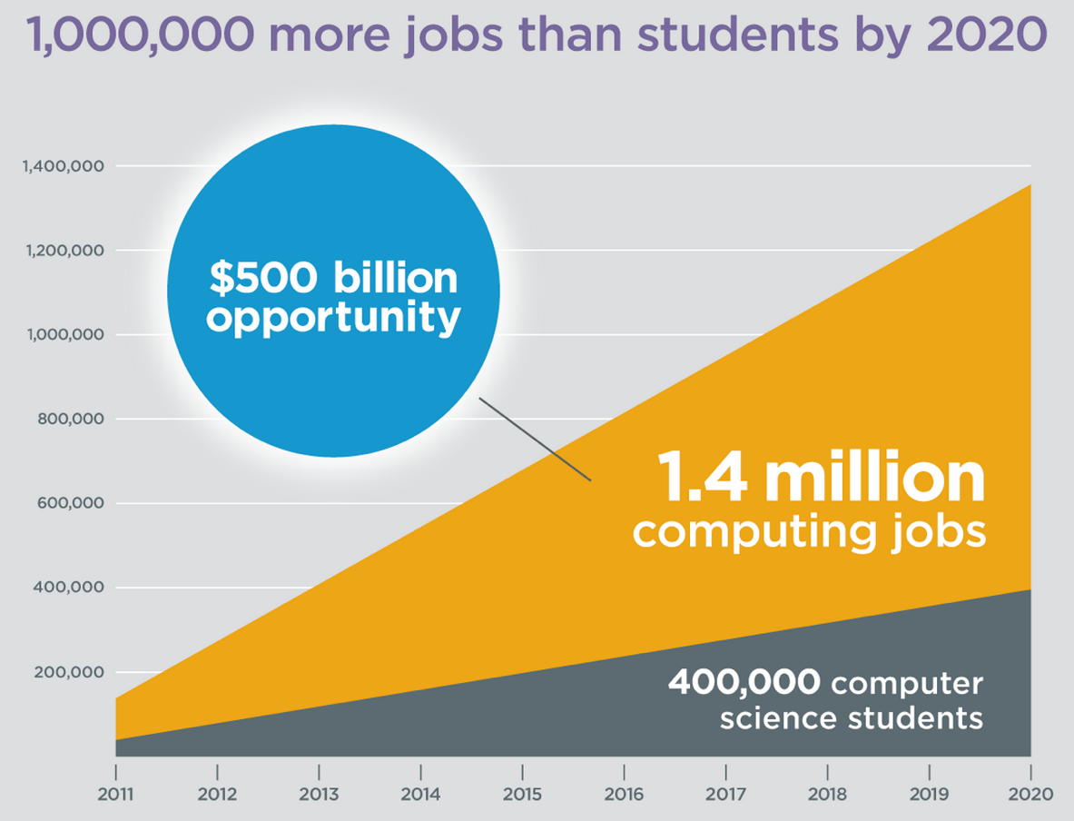
It’s Useful
Code.org

Slide 111
It should fit your culture

Slide 112
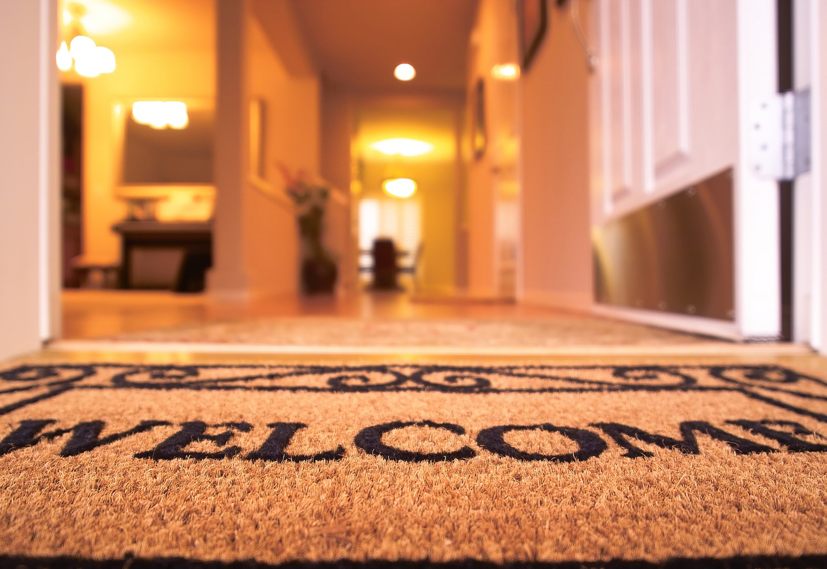
(make it so that) Everyone is Welcome

Slide 113
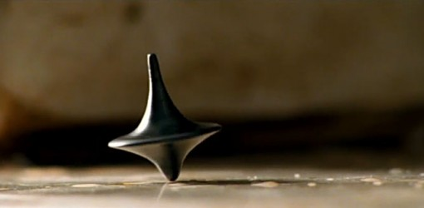
The End?
Submit your projects by 6pm!

